Slide 1









My Number Interactive Notebook
$$×$$
$$\frac{1}{2}$$
$$÷$$
$$+$$
$$−$$
$$\frac{3}{5}$$
$$7$$
Name
Class
Teacher
Term 1 Semester 1
$$5^{2}$$
$$\sqrt{9}$$
1

Slide 2
Contents
Glossary or Formula Page
Page
Date
Description
2
3

Slide 3
Tasks
24
7
30
Essential Question
Questions
Notes
Summary
6
7

Slide 4
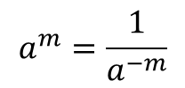
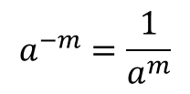
24
7
30
Date
Negative Indices
EQ – Describe the effect of a negative indices on a number.
What is the rule for negative powers?
$$a^{−m}=\frac{1}{a^{m}}$$
$$a^{m}=\frac{1}{a^{−m}}$$
Examples
5

Slide 5
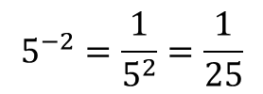
24
7
30
Date
Negative Indices
EQ – Describe the effect of a negative indices on a number.
What is the rule for negative powers?
$$a^{−m}=\frac{1}{a^{m}}$$
$$a^{m}=\frac{1}{a^{−m}}$$
Write with positive indices
Examples
$$5^{−2}=\frac{1}{5^{2}}=\frac{1}{25}$$
5

Slide 6
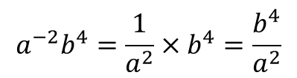
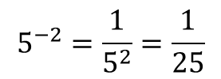
24
7
30
Date
Negative Indices
EQ – Describe the effect of a negative indices on a number.
What is the rule for negative powers?
$$a^{−m}=\frac{1}{a^{m}}$$
$$a^{m}=\frac{1}{a^{−m}}$$
Examples
$$5^{−2}=\frac{1}{5^{2}}=\frac{1}{25}$$
$$a^{−2}b^{4}=\frac{1}{a^{2}}×b^{4}=\frac{b^{4}}{a^{2}}$$
5

Slide 7
Notes Review
24, 7 ,30
Date
Title
Essential question
Notes complete
Notes complete with colour and diagrams
Questions completed
Contents page filed in
Formula page filled in

Slide 8
Homework
Review your notes and write a summary answering the essential question.

